Slide 1
FUNGAL DISEASES

Slide 2
FUNGAL DISEASES
Tissue invasion Mycoses
Toxin production Mycotoxicosis
Induction of hyper sensitivity

Slide 3
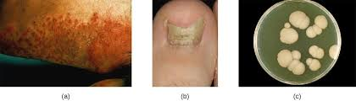
MYCOSES
Category | Sites of lesions
Superficial mycoses | Epidermis, other keratinized structures and mucous membrane
Subcutaneous mycoses | Subcutaneous tissues
Systemic mycoses | Respiratory and digestive tract and other organ systems

Slide 4
Factors predispose to fungal invasion of tissues
Immunosuppression
Prolonged antibiotic therapy
Immunological defects
Immaturity, ageing and malnutrition
Exposure to heavy challenge of fungal spores
Traumatized tissues
Persistent moisture on skin surface
Some neoplastic conditions

Slide 5
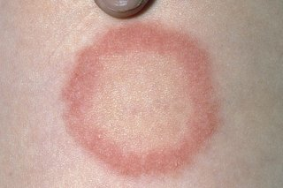
Diagnosis of Fungal Diseases
Clinical signs and history ( dermatophytes)
Hair and skin scrapping in superficial mycoses
Biopsy or post mortem specimens in subcutaneous and systemic mycoses
Specimens should be collected from the periphery of active lesions

Slide 6
Diagnosis contd.
Direct microscopic examination
In ring worm anthrosprores sorrounding infected hair or hypahae in infected tissue may be demonstrable in 10% KOH
Cryptococcus neoformans can be demonstrated in cerebrospinal fluid India ink or Nigrosin, as budding cells with wide capsules
Sporing heads of Aspergillus, Penicillium by staining with Lactophenol cotton blue stain
Slide culture technique and transparent adhesisve tape technique
Yeast cells can be stained with methylene blue or by the
Gram method.

Slide 7
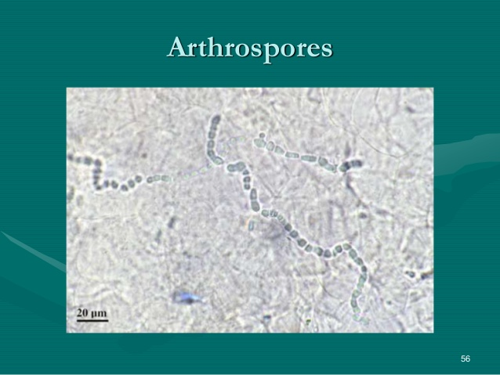

Slide 8
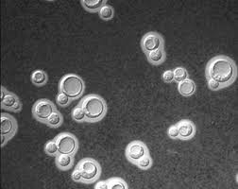

Slide 9
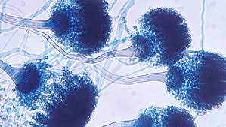
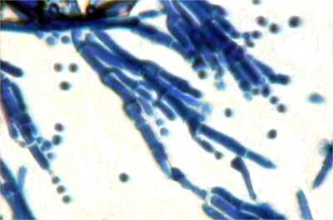
Aspergillus
Penicillium

Slide 10
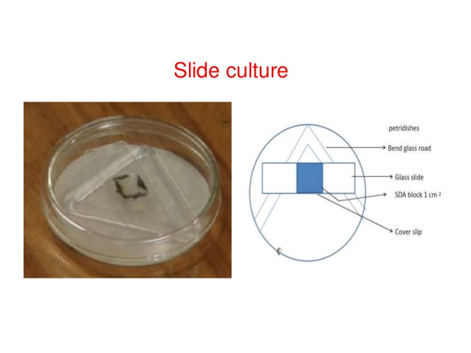
SLIDE CULTURE TECHNIQUE
One plate of nutrient agar; potato dextrose is recommended
some fastidious fung imay require harsher media to induce sporulation like corn meal agar or Czapek dox agar.

Slide 11
SLIDE CULTURE PREPARATIONS
Using a sterile blade cut out an agar block (7 x 7 mm) small enough to fit under a coverslip.
Flip the block up onto the surface of the agar plate.
Inoculate the four sides of the agar block with spores or mycelial fragments of the fungus to be grown.
Place a flamed coverslip centrally upon the agar block.
Incubate the plate at 26C until growth and sporulation have occurred.

Slide 12
SLIDE CULTURE PREPARATIONS
Remove the cover slip from the agar block.
Apply a drop of 95% alcohol as a wetting agent.
Gently lower the coverslip onto a small drop of Lacto phenolcotton blue on a clean glass slide.
The slide can be left overnight to dry and later sealed with finger nail polish.
When sealing with nail polish use a coat of clear polish followed by one coat of red Coloured polish.

Slide 13
Need for Slide Culture
Most moulds will yield good results , but a few present extra difficulties. The most problematic are those that tend to disintegrate as soon as they are mounted
Species of Cladosporium, Monilia, and Alternaria have spores connected in very fragile chains that can fall apart at the slightest movement of air.
Mounts of these fungi invariably reveal only loose spores and a network of hyphae. To overcome this problem it is useful to set up slide cultures

Slide 14
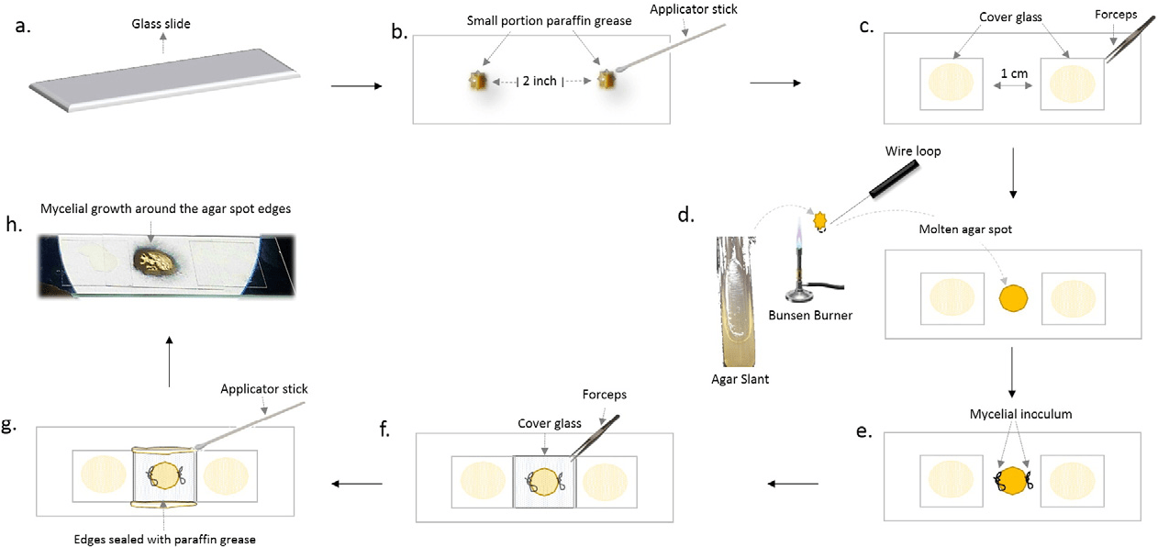

Slide 15
culture
Fungi are usually isolated on Sabouraud dextrose agar (pH 5.5) which inhibits growth of most bacteria.
The addition of chloramphenicol and cycloheximide increases selectivity by inhibiting some of the fast-growing contaminating fungi such as the zygomycetes
To stimulate growth of the yeast phase of dimorphic fungi, enriched media, such as brain–heart infusion agar with 5%
blood, and incubation at 37°C are required.

Slide 16
HISTOPATHOLOGY
Histopathological demonstration of fungal hyphae or yeast forms is usually necessary for confirmation of the significance of isolates from deep mycotic infections.
The periodic acid- Schiff (PAS) reaction or methenamine silver impregnation can be used to demonstrate fungal
elements in tissue sections.

Slide 17
DERMATOPHYTES
invade superficial keratinized structures such as skin, hair and claws.
Members of the phylum Ascomycota
Microsporum, Trichophyton and Epidermophyton
Arthrospores (arthroconidia) are the infectious forms most often associated with tissue invasion by this group of fungi. They are released by fragmentation of hyphae in keratinized structures.
These resistant forms can remain viable for more than 12 months in suitable environments in buildings.

Slide 18
Dermatophytes are strict aerobes, most of which grow slowly on standard Sabouraud dextrose agar.
Afew require special growth factors which are supplied by the addition of yeast extract to the Sabouraud dextrose agar.
Macroconidia and microconidia are produced in culture
The colonies of many dermatophytes are pigmented.
Colonial morphology and the type of macroconidia produced are used for identification

Slide 19
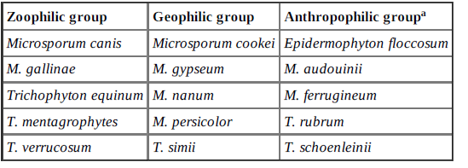
Dermatophytes grouped according to host preference or habitat

Slide 20
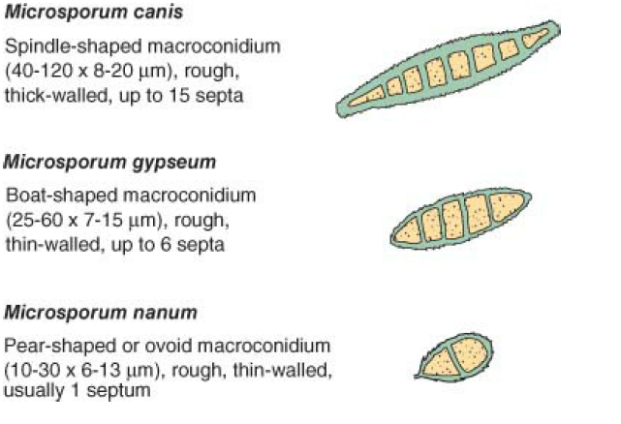

Slide 21
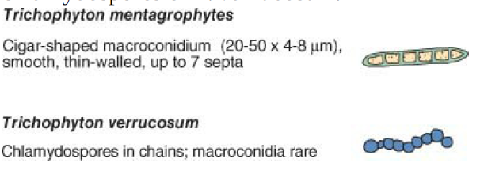

Slide 22
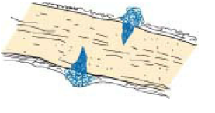
Some dermatophytes such as M. canis and T. mentagrophytes produce this
hair perforation pattern.

Slide 23
Pathogenesis and pathogenicity
Dermatophytes invade keratinized structures such as the stratum corneum of the epidermis, hair
follicles, hair shafts and feathers.
Lesion development is influenced by the virulence of the dermatophyte and the immunological competence of the host.
Young, aged, debilitated and immunosuppressed animals are particularly susceptible to infection
Direct contact with an infected host or indirectly through infected epithelial debris in the environment.
Damp skin surfaces and warmth favour germination of spores.

Slide 24
Metabolic products of hyphal growth may provoke a local inflammatory response.
Hyphae grow centrifugally from the initial lesion towards normal skin producing typical ringworm lesions.
Alopecia, tissue repair and nonviable hyphae are found at the centres of lesions as they develop.
Growth of hyphae can result in epidermal hyperplasia and hyperkeratosis.
Secondary bacterial infection sometimes follows mycotic folliculitis.

Slide 25
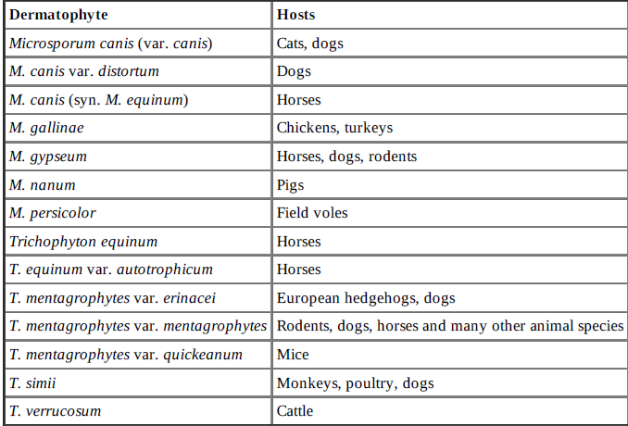

Slide 26
DIAGNOSIS
As dermatophyte species tend to parasitize particular hosts, the animal species affected may
indicate the dermatophyte most likely to be involved
Specimens suitable for laboratory examination include plucked hair, deep skin scrapings from the
edge of lesions, scrapings from affected claws, and biopsy material from pseudomycetomas.
Suitable material from cats can also be collected on a large sheet of paper by brushing the coat
with a clean toothbrush.
Hairs and skin scrapings treated with KOH should be examined microscopically for the presence
of arthrospores. The arrangement of arthrospores on hair shafts is typically ectothrix
Histological sections of skin or pseudomycetomas can be stained by the PAS or methenamine
silver techniques to demonstrate fungal structures.

Slide 27
Specimens are cultured on Emmon’s Sabouraud dextrose agar (pH 6.9) with the addition of 2 to
4% yeast extract, 0.05g/litre chloramphenicol and 0.4 g/litre cycloheximide. I
Inoculated plates are incubated aerobically at 25°C to 27°C and examined twice weekly for up to 5 weeks.
Identification criteria for isolates:
– Colonial morphology
– Microscopic appearance of macroconidia
– Supplementary tests including growth on DTM medium.
Several DNA-based techniques such as PCR
In cats and dogs with suspicious lesions, examination with Wood’s lamp should always be
carried out because M. canis infections are comparatively common in these species. A
characteristic apple-green fluorescence from infected hairs is evident

Slide 28
Dermatophytosis in cats and dogs
Microsporon canis
Clinical features of the disease include classical
ringworm lesions, miliary dermatitis, pseudomycetomas
lime sulphur or miconazole shampoo may be effective
Itraconazole, fluconazole or terbinafine, administered orally, are the drugs of choice for systemic therapy

Slide 29
Dermatophytosis in cattle
Trichophyton verrucosum
Commercial vaccines containing an attenuated strain of T. verrucosum (LTF-130 or CCM 8165) have been used successfully for the control of bovine dermato- phytosis in Europe and Russia

Slide 30
Dermatophytosis in horses byTrichophyton equinum
Dermatophytosis in pigs by M. nanum.

Slide 31
Favus in poultry
M. gallinae
White patchy crusts develop on the comb and wattles.

